Slide 1
Name Entity Recognizer
Bot: Where is our President?
Me: President Trump is in Germany now.
Trump - PERSON
Germany - LOCATION
Now - DATE

Slide 2
NLP vs NLU
Natural Language Processing
Process language data for Speech Recognition, Text Summarization
Natural Language Understanding
Examine what a body of text really means for Question & Answering and etc.

Slide 3
Name Entity Recognition
Locate and classify named entities
Entity categories: PERSON, LOCATION, DATE, ORGANIZATION, NUMBER, etc.
Bot: Where do you want to travel?
Me: I want to have 7 day vacation in Paris
Bot: When you
7-day : NUMBER
PARIS: LOCATION

Slide 4
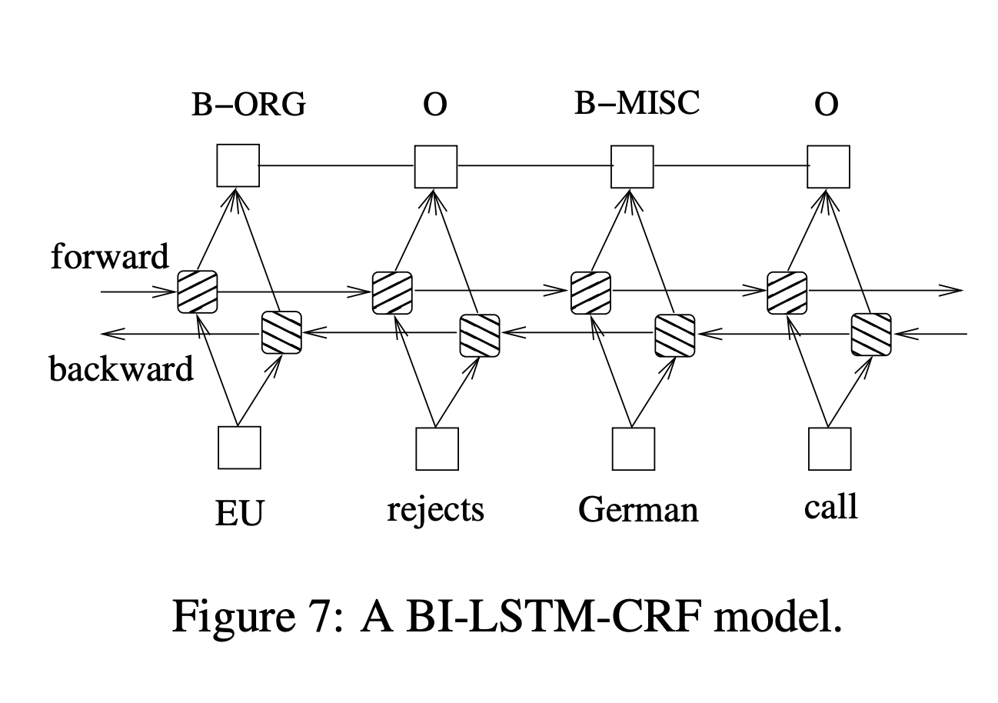
Today
BiLSTM-CRF
BiLSTM - Bidirection Long-Short-Term-Memory
CRF - Conditional Random Field
Source: BiLSTM-CRF

